Slide 1









Hello everyone, Let's Play a game
Theme : UNIT 1,2,3,4,5

Slide 2





How to Play?
Choose the correct answer

Slide 3





Are you ready?
Let's get started

Slide 4



Question No.1
If your friend always tells the truth, he/she is...........
A) Honest
B) Liar
C) Thoughtful
D) Cool

Slide 5




The answer is...
A) HONEST

Slide 6





Question no.2
If your friend doesn’t share his/her pencil with you, he/she is .........
A. Indonesia
A) Trustful
B) Cool
C) Mean
D) Stubborn

Slide 7



The answer is,,,
C) Mean

Slide 8
Question No.3
If your friend can keep your secrets, she/he is ..........
A) Punctual
B) Loyal
C) Selfish
D) Smart

Slide 9
The answer is...
B) Loyal

Slide 10
Question no.4
If you say something wrong to your friend, you should..............
A. Indonesia
A) Apologize
B) Comment on
C) Invite
D) Have a party

Slide 11
The answer is,,,
A) Apologize

Slide 12
Question No.5
If your friend makes you a cup of tea when you are sick, she/he is ..........
A) Sneaky
B) Jealous
C)Understanding
D) Caring

Slide 13
The answer is...
D) Caring

Slide 14
Question no.6
A. Indonesia
What does “ridiculous” mean?
A) Saçma
B) Görkemli
C) Tahammül edilemez
D) Kaba

Slide 15
The answer is,,,
A)Saçma

Slide 16
Question No.7
What does ‘’TRAVEL’’ mean?
A) Seyahat etmek
B) Gezintiye çıkmak
C) Tatile gitmek
D) Yurtdışına çıkmak

Slide 17
The answer is...
A) Seyahat Etmek

Slide 18
Question no.8
Which one is an outdoor activity?
A. Indonesia
A) Surf the internet
B) Go to gym
C) Pitch a camp
D) Have a shower

Slide 19
The answer is,,,
C) Pitch a camp

Slide 20
Question No.9
Which one is included in the daily routine?
A) Brush teeth
B) Ride bicycle
C)Go to cinema
D) Play chess

Slide 21
The answer is...
A) Brush Teeth

Slide 22
Question No.10
If you like art, you should ........
A) Play football
B) Go to a museum
C) Watch tv
D) Try new recipes

Slide 23
The answer is,,,
B) Go to a museum

Slide 24
Question no.11
Linda loves Italian ............
She eats pasta everyday!
A. Indonesia
A) Mixture
B)Process
C) Step
D) Cuisine

Slide 25






the answer is...
D) Cuisine

Slide 26
Question No.12
........ the pasta with a strainer.
A) Mash
B) Pour
C) Drain
D) Whisk

Slide 27
The answer is...
C) Drain

Slide 28
Question no.13
You must ............ the soup with a spoon when it’s boiling.
A. Indonesia
A) Stir
B) Knead
C) Pour
D) Crack

Slide 29
The answer is,,,
A) Stir

Slide 30
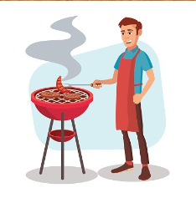
Question No.14
Hasan usually .......... the meat.
A) Boils
B) Bakes
C) Grills
D) Fries

Slide 31
the answer is...
C) Grrills

Slide 32
Question no.15
You can put two gloves of garlic in the sauce to add ..........................
A. Indonesia
A) Salt
B) Flavor
C) Oil
D) Mixture

Slide 33
The answer is...
B) Flavor

Slide 34
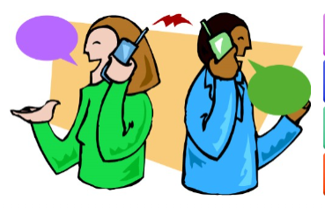
Question No.16
Which one is correct for the picture?
A) Text a message
B) Bad connection
C) Appointment
D) Conversation

Slide 35
The answer is,,,
D) Conversation

Slide 36
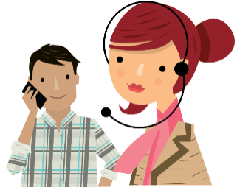
Question no.17
Which one is correct for the picture?
A. Indonesia
A) Customer Services
B) Connect
C) Pick up
D) Reservation

Slide 37
the answer is...
A) Customer Services

Slide 38
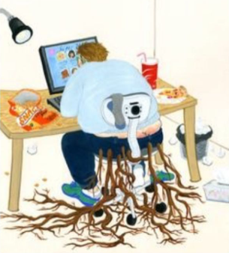
Question No.18
What is this picture about?
B) Computer Magazines
A) Practical Purpose
D) Educational web page
C)Interent addiction

Slide 39
The answer is...
C) Internet addiction

Slide 40
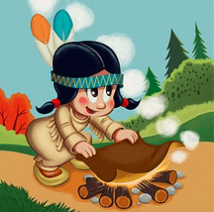
Question no.19
Which way of communication does she use in the picture?
A. Indonesia
A) Smoke Signals
B) Write a letter
C) Messenger birds
D) Face to face

Slide 41
The answer is,,,
A) Smoke signals

Slide 42
Question No.20
I miss my friends during the summer holidays so I ............. with them.
A) Make new friends
B) Keep in touch
C) Download songs
D) Do online shopping

Slide 43
the answer is...
B) Keep in touch

Slide 44

Question no.21
What is the meaning of this symbol?
A. Indonesia
A) Click
B) Log in
C) Download
D) Upload

Slide 45
The answer is...
D) Upload

Slide 46
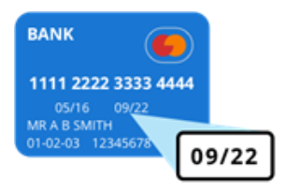
Question No.22
What do you see in the picture?
A) Credit card number
B) CVV number
C) Expiry date
D) ID number

Slide 47
The answer is,,,
C) Expiry date

Slide 48

Question no.23
To change the language of the web site you should click on ...........
A. Indonesia
A) Settings
B) Etiquette
C) Advice
D) Source

Slide 49
the answer is...
A) Settings

Slide 50
Question No.24
What does ‘’ASAP’’ mean?
A) Geri döneceğim
B)Görüşmek üzere
C)Sesli güldüm
D) Mümkün olan en kısa sürede

Slide 51
The answer is,,,
D) Mümkün olan en kısa sürede

Slide 52
Question no.25
A. Indonesia
I shouldn’t use internet to .............
A) Disturb people
B) Do online shopping
C) Pay bills
D) Watch videos

Slide 53
The answer is...
A) Disturb people

Slide 54
Thankyou for playing

